Slide 1
Team Inter: Surgical Site Infection Prediction Model
114
Maryam Ahmadi, Adrian Kieback,
Anna Krause, Kate Martsul

Slide 2
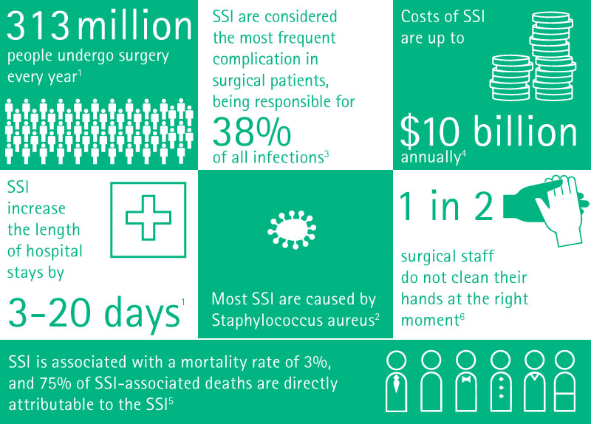
We want to build a model to predict Surgical Site Infections that has the potential to help hospitals operate more efficiently and safely.
114
Surgical Site Infections (SSIs) occur when a patient develops an infection post surgery
SSIs are dangerous, expensive, and preventable
A successful SSI prediction model may help patients, doctors, other medical staff, and hospital admins
SSIs are a continuously pressing, real-world issue that hospitals face
Our primary dataset contains six years (2015-2021) worth of SSI’s reported by CA hospitals to the CDC and NHSN
Source

Slide 3
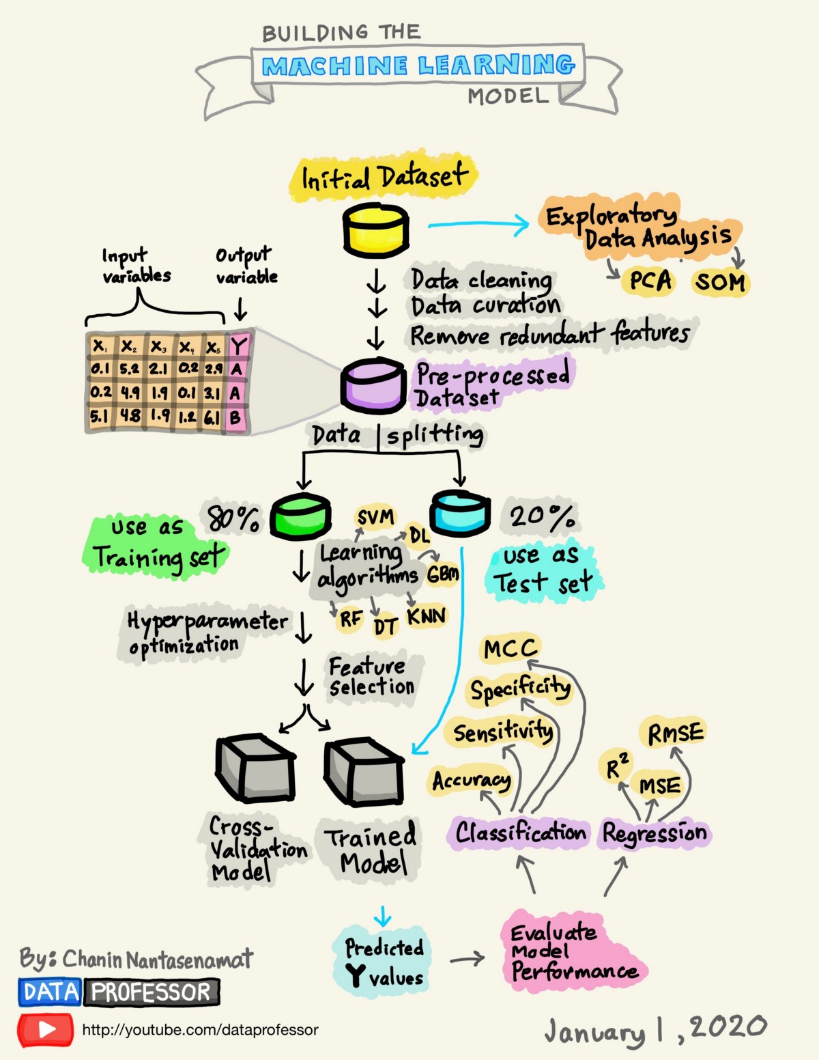
Our Model
114
We plan to build a classification model that will assess the risks of SSI’s based on type of Surgery and aspects of the Facility where it took place
Sharp Healthcare has resources that can counteract the limitations within our current databases
Our team is personally invested within this issue, and wants to continuously collaborate with Sharp Healthcare to build the most successful SSI prediction model
This has the potential to be used as a standard risk assessment tool within Sharp Healthcare, and can be expanded to other California Healthcare Facilities
source

